Slide 1


WICCI Entrepreneurship Development council
WOMEN´S INDIAN CHAMBER OF COMMERCE AND INDUSTRY
www.wicci.in

Slide 2

Council Vision &Mission
Vision:
Inspire women to start their Entrepreneurial journey and to make them a job provider instead of Job seeker by guiding and supporting them with the available facilities and government scheme for MSME and start up enterprises lead by women.
Mission:
To become a Sarthi for women led MSME and Start up to provide sustainable growth and profitability. As women enterprises are not aware about benefits available and procedure to leverage the same, we are keen and passionate to support and guide women led small business to become a globally competitive organization.
To inspire and empower women through collaborative approach from women entrepreneurs from diversified functional area. Collaboration instead of competition is the mantra for the council

Slide 3
Welcoming
Council Members to
WICCI
President, Vice President
and 20+ Nominated Council Members

Slide 4
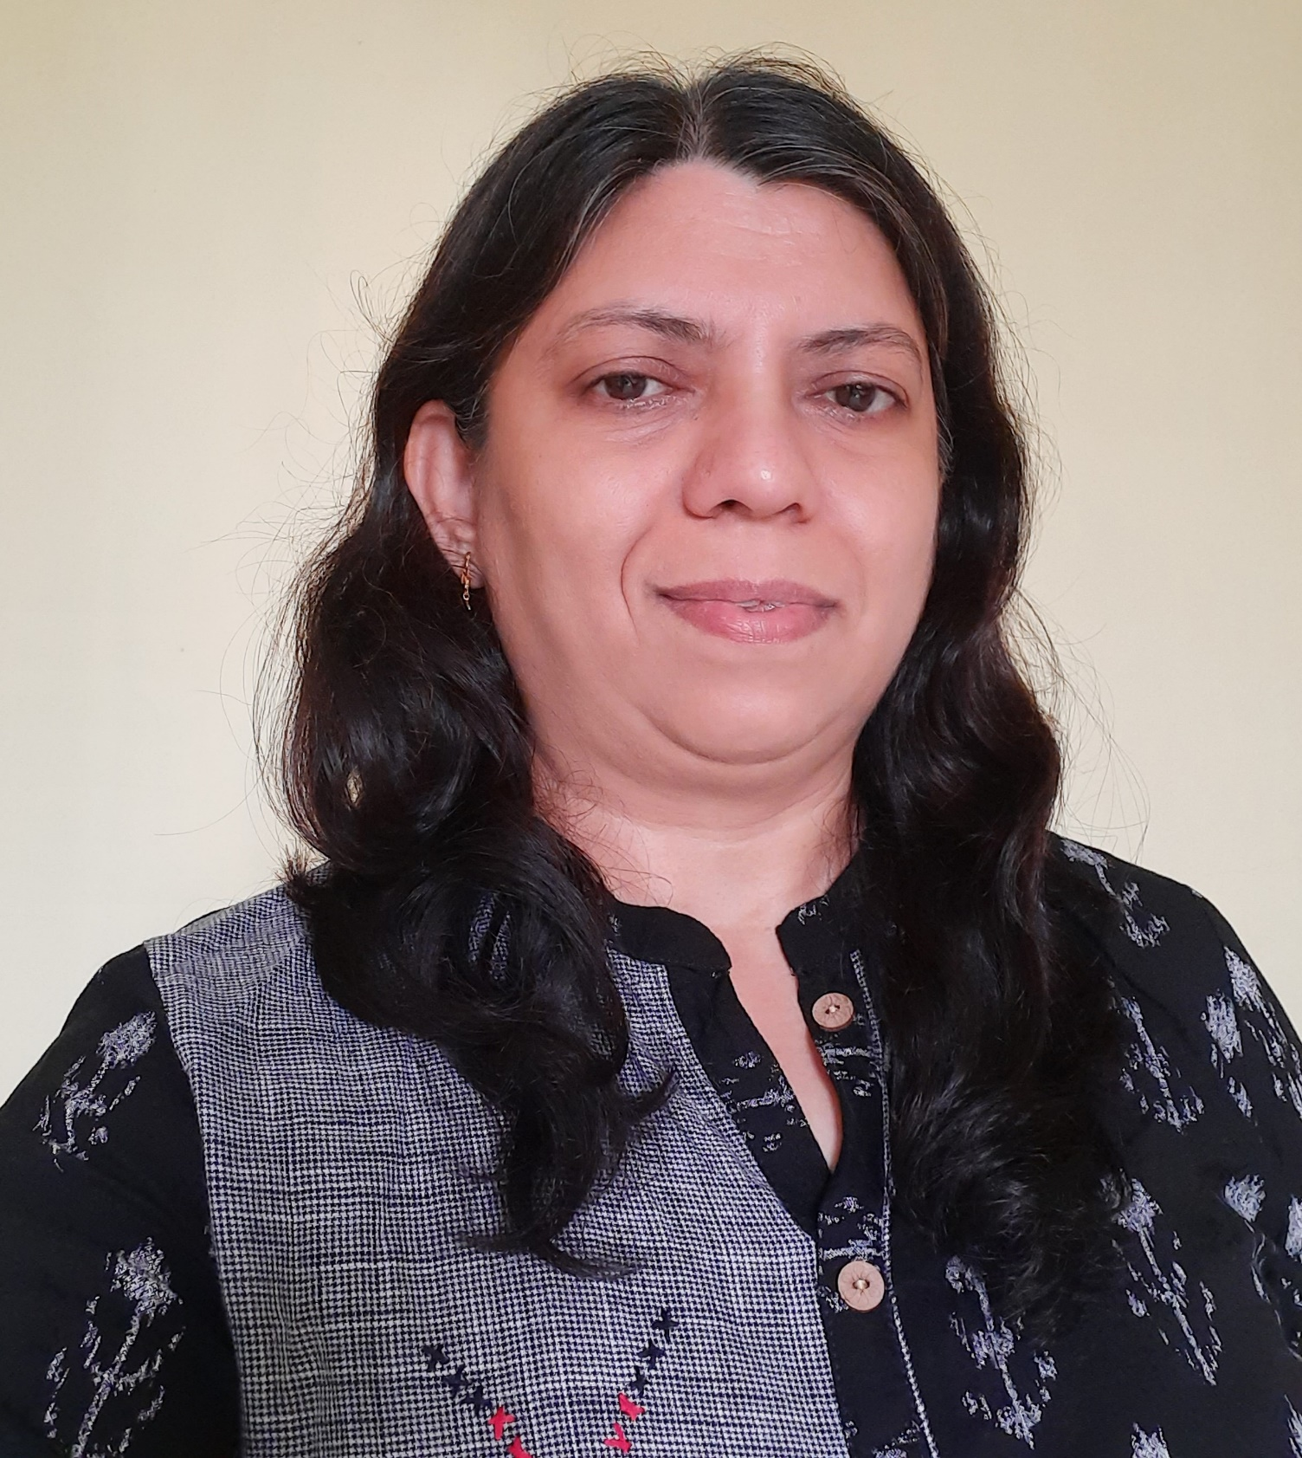
Darshana Thakkar – President
WICCI Entrepreneurship Development council
Darshana Thakkar is an expert in Transformation of the business that helps business in achieving growth with speed and scale.
She an Electrical Engineer followed by MBA-Operations with hardcore industry experience in managing business operations.
She has invested 27 years in Transforming Micro and Small Enterprises.
Her rich experience in managing and resolving pain areas and the real-life problem of the MSME companies are helping the client organization to obtain quick results
She is keen for the growth of Indian Start ups , so providing mentoring & hand holding support to start ups to make them succeed at fast pace.
She is very much passionate to support women in pursuing their career and life goal. She is working very actively for women entrepreneurship and women leadership development.
She is associated with Government of Gujarat for Start ups.
She has received several accolades and recognition for her contributions to MSME and Start up Ecosystem along with few media coverage.

Slide 5
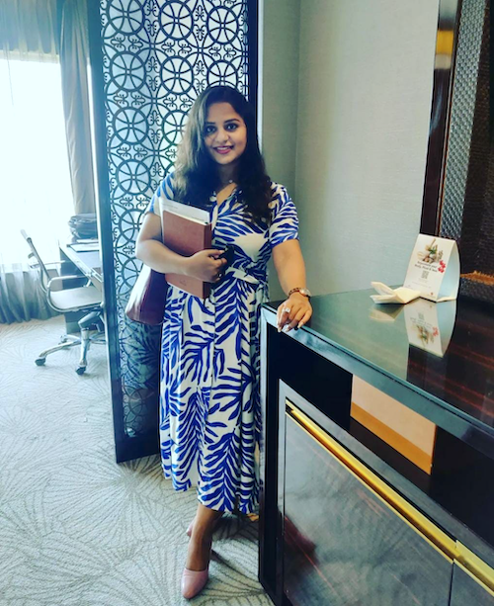
Priyanka Pandey – Vice President
WICCI Entrepreneurship Development council
Priyanka has started her career by joining the finance division in Indian Oil Corporation Limited (IOCL). After that she founded Tax Arena, a taxation and business consulting venture with all round services for Indian MSMEs, industries and corporates successfully. Passion towards technology motivates her to start a tech startup. She co-founded Zauvijek an IT company, which offers IT products, services and technology partnerships for Enterprises not only in India but across the globe.
An enterprising tech CEO and director with a passion for innovation and technology, having extensive experience in leading successful software development teams, with a proven track record of creating cutting-edge software solutions that exceeds businesses and enterprises expectations.
She is the winner of Tanishq Rivaah Face of Bihar 2022. Also, got awards from Dr. Bhagwat Karad, Minister of State for Finance, Governemnt of India

Slide 6
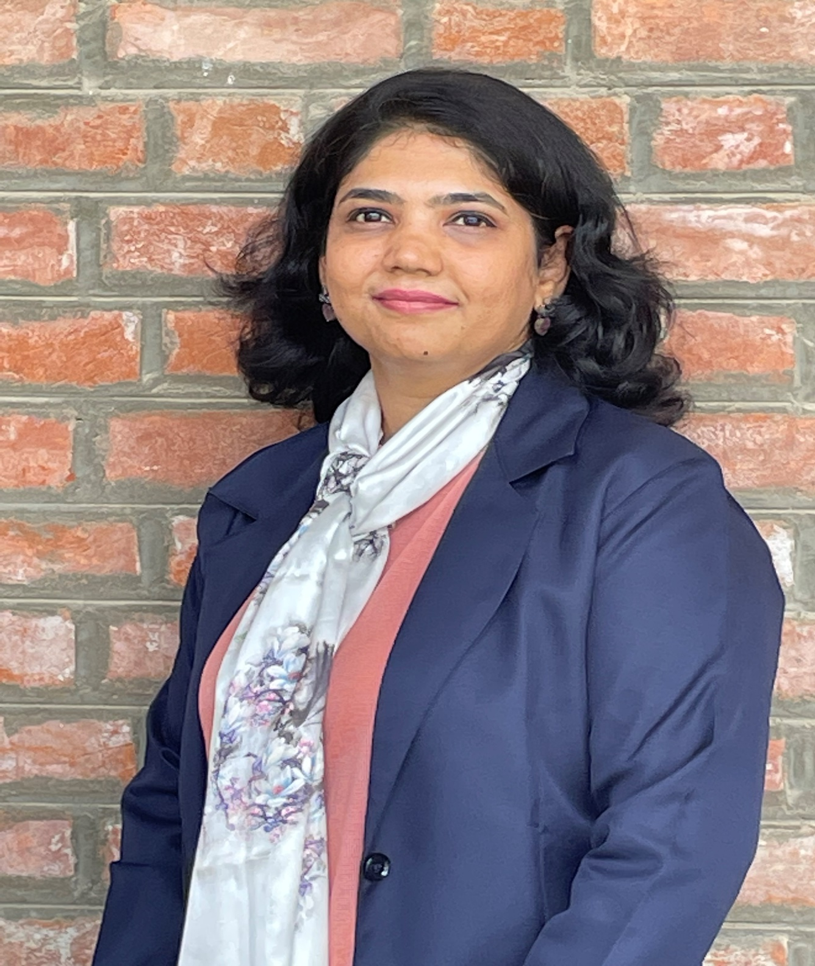
Chinar Shah – National Council Member
WICCI Entrepreneurship Development council
Chinar Shah A Passionate Business Consultant with 18+ years experience working in Business Strategy, Operations Excellence & Human Resources. She has a strong track record in setting up,scaling and transforming businesses.
She is Director & Chief Strategy Officer at Strawberry Enterprise Pvt Ltd. Strawberry Enterprise is pioneer in Business Consulting, Industry Automation, Research & Development,Education & Trainings, Financial Consulting & Advisory, and Trading.
➢ A strategist, helping Organizations to Achieve Business Objectives and Drive towards
Excellence with Strategic Planning and Process Implementation.
➢ Meticulous in various areas of HR, such as Talent Acquisition, HR Operations, Talent
Management, HR Generalist, Statutory Compliances, Shared Services, Labor Laws and
Employee Relations.
➢ An integral contributor towards automation of HR processes.
➢ Proven skills and expertise in Achieving Breakthrough Goals with her Strong Intent,
Analytical Thinking, Growth Mindset and Result Orientation.
➢ Expert in Evolving Business Strategy and Work Culture, Fostering Organization Development
with Change Management.
➢ Helping organizations to achieve Sustainable Growth and Increased Profitability, with her
Proven Strategies and Trusted Advisory.

Slide 7
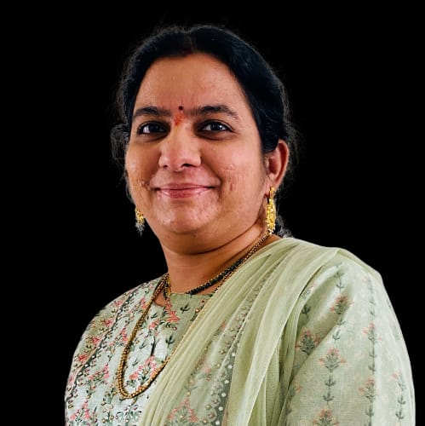
AAravinda Garikipati – National Council Member
WICCI Entrepreneurship Development council
Aravinda is a highly experienced Fellow Chartered Accountant with over 17 years of professional experience in the field of direct tax. She holds a master’s in financial management from Pondicherry University and has completed a few certification courses from ICAI related to International Taxation, Anti money laundering laws, Certified ESG Practitioner and BRSR course from IICSR Mumbai. She has extensive knowledge in handling various income tax-related issues such as tax advisory, tax litigation which includes assessments, appeals, repatriation of funds, DTAA issues, , NRI tax issues and incorporation of companies/LLPs. Aravinda is a firm believer in promoting green energy and offers assistance in solar adoption. In addition to her tax expertise, Aravinda is also a mentor for startups and MSMEs and ATL Mentor for Change, a strategic advisor to the MSME Business Forum India, and a Qualified Independent Director from IICA. She has around 7 years of experience working for PwC in the direct tax division and holds certificates in International Taxation, Anti-Money Laundering Laws, and Transfer Pricing Laws. She writes articles and blogs regularly. As a member of the Direct Tax Committee of The Federation of Telangana Chambers of Commerce and Industry (FTCCI , Telangana ). Aravinda is committed to providing high-quality services while promoting sustainable business practices. She is the proprietor of Aravinda and Associates and is dedicated to helping businesses navigate the complexities of tax laws.

Slide 8
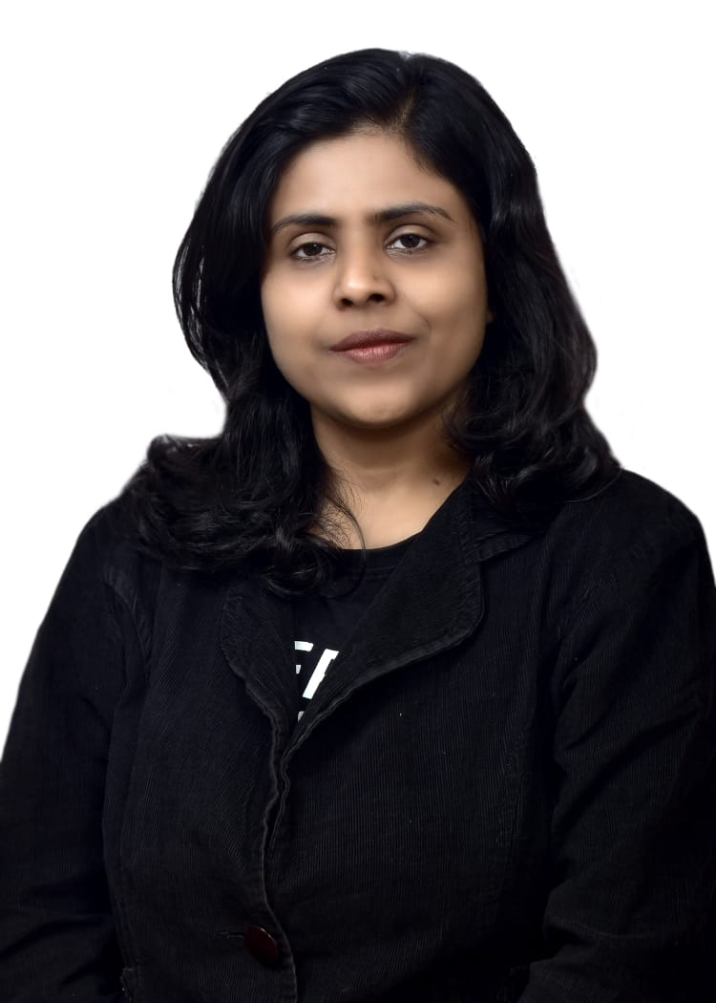
Ritika Tantia – National Council Member
WICCI Entrepreneurship Development council
RITIKA TANTIA is a CA and PROPRIETOR of M/S NART & CO.
N A R T & Co. was established in 2012 with the principal objective of providing value based services of highest standard to our clients as per their needs. We are engaged in providing chartered accounting services, financial and consultancy services, auditing services, internal auditing services, statutory auditing services, income tax services, services for company law matters, GST matters. With years of rich experience and credibility to back up, N A R T & Co. has always been able to meet the client's specific requirement
Providing serves in the following area :
Subsidy, Leasing, Electric Vehicle, Solar Rooftop
Accounting Services
Project Report
Auditing & Assurance Services
Income Tax Services
Finance Division
Company Law Matters Consultancy
Societies and Trust Consultancy
GST Consultancy

Slide 9
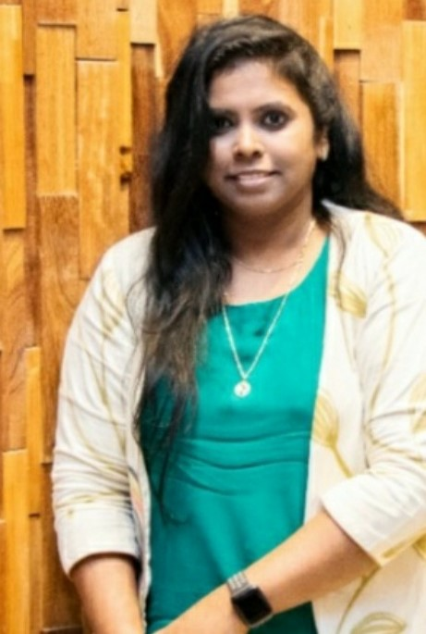
Arunna Raj – National Council Member
WICCI Entrepreneurship Development council
Arunna Raj is a Visionary l Entrepreneur l Consultant l Traveller l Music Enthusiast l Environmentalist l Humanitarian
Founder of is Amethyst Consulting . It mainly work on Project Management Consultancy and Investments . Currently I'm working with projects based in Oman and Africa.We help companies scale up from ideation into transformed brands and help them with their global presence
Founder of Citrine Techno Economic Consultants which is into Cluster Development and Country Development Projects. In future, I would like to have my own IT company and would also like to venture into various sectors and probably have a Center of Excellence for Artificial Intelligence.
Accomplishments :
* President of Asian African Chamber of Commerce.
* CEO at Aviation Chamber of Commerce
* Associated with 28COE Community
* Women Entrepreneur of the Year in Wonder Women Awards .
* Young Women Achiever in India Business Awards.
* Awarded at Asian African Chamber of commerce
* Featured in SHE Magazine

Slide 10
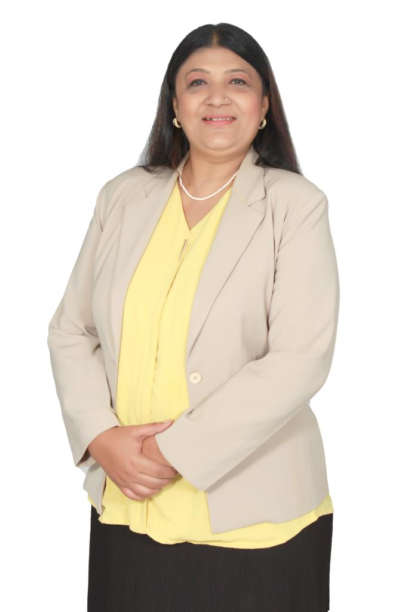
Manisha Thakar – National Council Member
WICCI Entrepreneurship Development council
Ms. Manisha Thaker, Vice President Trialliance Global Solutions India Pvt ltd Faculty for Exports and Imports
She is a co-founder of Namaste India Exportors.
20 +years in Logistics , Shipping and supply chain for General cargoes as well as odd dimensions cargoes. She is specialized in handling bulk , Breakbulk and Project Cargoes.
Apart from her profession in logistics and supply chain , She is into teaching and knowledge sharing and has been a trainer/mentor and guest faculty to various associations organisations , institutes , universities , Ministries etc to share the rich practical experience on international flow of logistics and supply chain management and other related topics of exports/imports. She has conducted 350 +seminars / webinars/open programs and mentored 5500+ participants from new startups Companies , Entrepreneurs , corporates officials and senior management personals , SMEs , MSMEs sectors , management students on how to start export business from India and other subjects related to export/import shipping , logistics , documentations and process flow and the challenges for a complete supply chain process
Ms. Manisha Thaker has been felicitated and won many awards & recognitions as Most Innovative company & Outstanding Woman Professional in imparting knowledge of exports to aspirants.

Slide 11
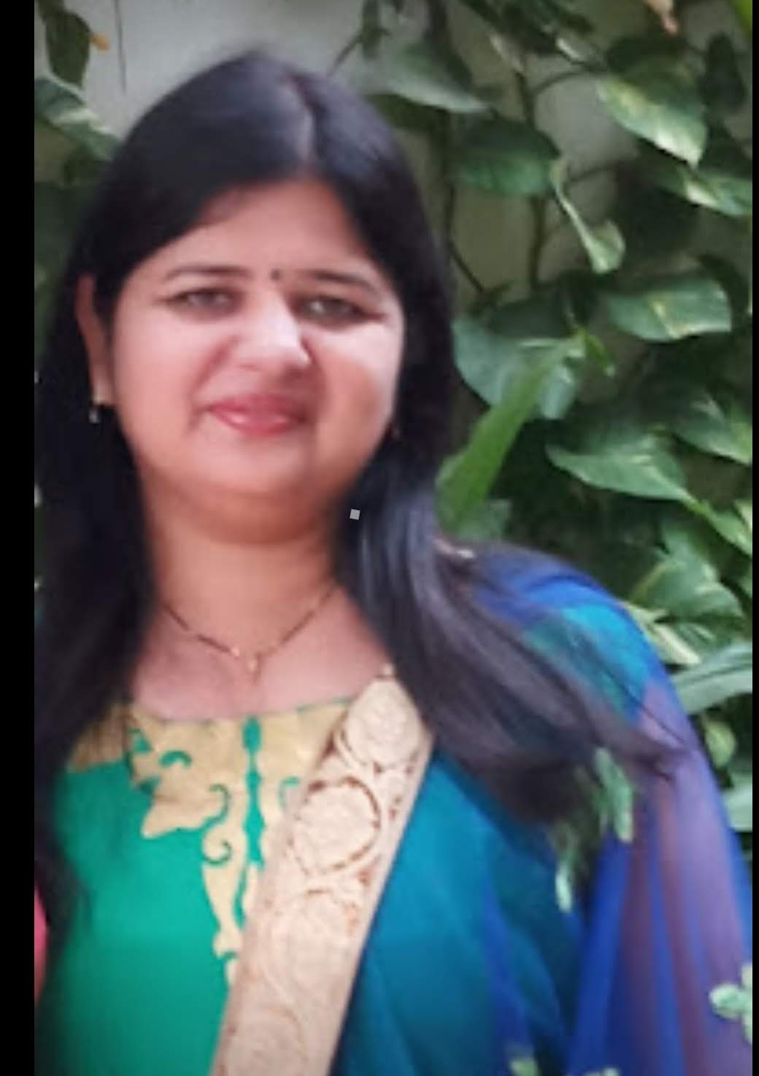
Hiral Shukla – National Council Member
WICCI Entrepreneurship Development council
At is founder of Hiral Shukla & Associates, my purpose is to build trust in society and solve important financial and Taxation problems.
Work Area:
➢ Accounting Services (Tally Accounting)
➢ Partnership registration
➢ Company Formation
➢ Trust and section 8 companies formation
➢ GST Registration and GST Compliances
➢ Income Tax Consultant(Tax Audit, Income Tax Return and other Advice)
➢ Internal Audit and Statutory Audit
➢ Business Consultancy
➢ PAN and TAN Card Consulting
➢ TDS Returns
➢ MSME registration and other advisory for the same
➢ HUF Formation
➢ Business loans and Housing loans services
➢ Advice to start ups
➢ Digital Signature

Slide 12
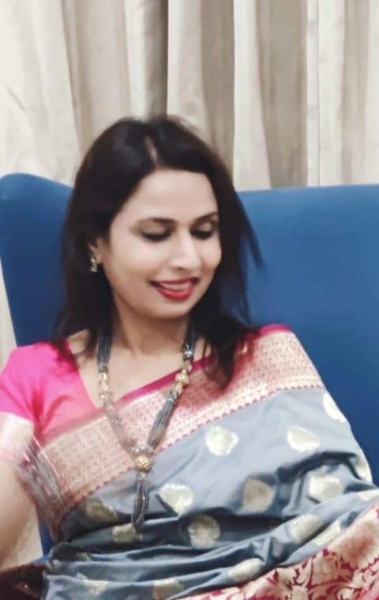
Dr. Mangla Chouhan – National Council Member
WICCI Entrepreneurship Development council
Dr. Mangla Chouhan
CEO & Founder
Midas Consultancy
Ph.D. ( Management)
Entrepreneur, Academician, Writer, Motivational Speaker, Researcher ,Mentor, Social Worker
Key Research Area:
Public Policy and Management
Her research basically based on rural areas and on women grievances.
She mainly works on emancipation of women in the various strata of society.
Attended various SWAGAT (State Wide Attentionon Grievances by Application of technology.

Slide 13
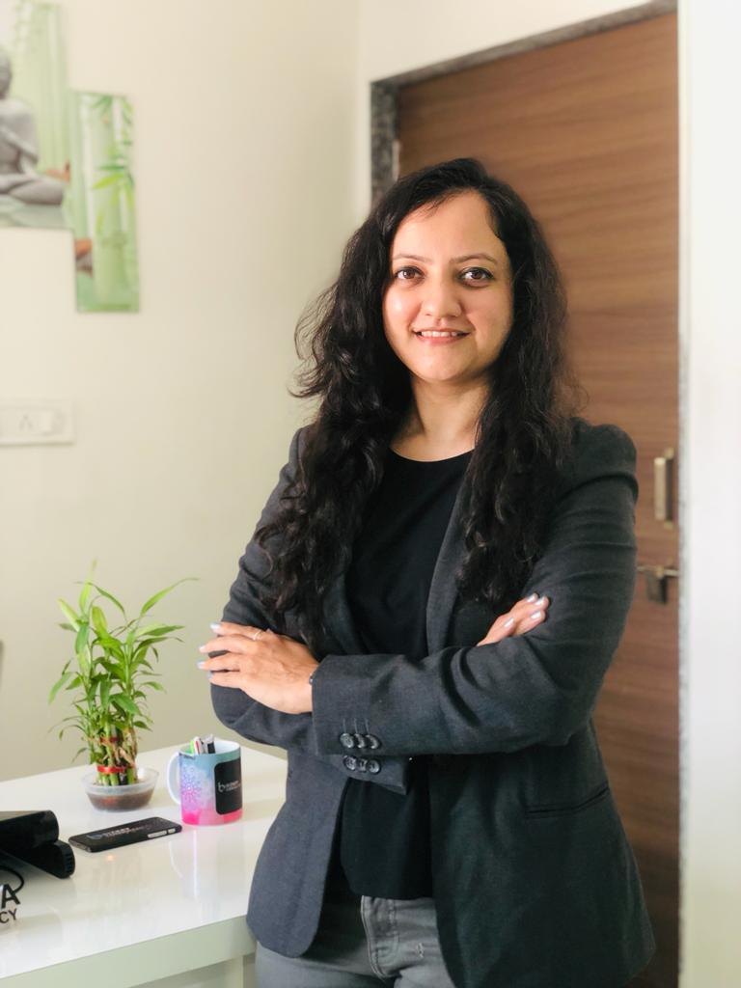
Vani Mehta – National Council Member
WICCI Entrepreneurship Development council
Vani Mehta, Founder and ISO Consulting Director at Bizkey Consultancy (Ahmedabad ,Gujarat)
Having Lead Auditor in all standards like ISO 9001/ISO 14001/ISO 45001/FSSC22000 V5/HACCP/GMP/ISO17025-2017(NABL) / Certified ZED Consultant Also having Awareness of AS 9100 ,SA 8000 and ISO 20000 - 1:2018(ITMS),
Awarded by Insight success magazine by Aspire media/ CED (The Centre for Entrepreneurship Development-Ahmedabad) , Women entrepreneur by INDIA 5000 ,The Aeonian-2021 and UK Consulting -ISO management Consultant -2023
Member of QCI(Quality Council of India) ,GCCI(Gujarat Chamber of commerce and Industry),AMA (Ahmedabad Management of Association)
“BizKey” is actively involved in the training, consultancy, and implementation of ISO standards like ISO 9001, ISO 14001, ISO 45001, food safety standards (ISO 22000, HACCP, GMP.FSSC, BRC, SQF), and laboratory standards (ISO /IEC 17025

Slide 14
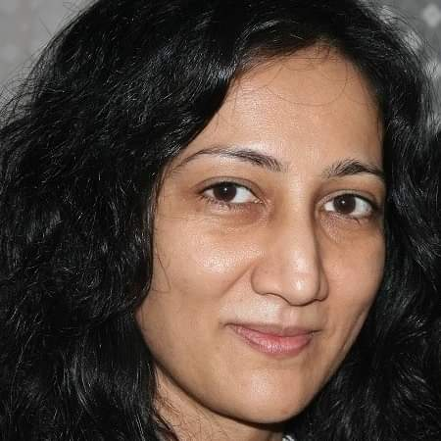
Deeti Dave – Sate president -Gujarat
WICCI Entrepreneurship Development council
Deeti Dave is a Founder at NX Smart Solutions, with keen interest and deep insights into consulting businesses to grow revenues, markets and scale up vertically and horizontally
▪ Founder at Sports Republica, promoting sports internationally, organizing sports events,
working on community development through sports with multiple partners
Professional Present:,
▪ 360 degree business consulting, from idea to product development, launch, go-to-market, growth consulting, funds raising, market expansion and penetration
▪ Product management and outsource management consulting
▪ Founder for NX Smart Solutions
▪ Director at Sanah Group LLC
▪ Advisor at Navinchandra Securities & Insurance Pvt Ltd
▪ Guest Faculty at Maharaja Ranjitsinh Design Institute (MRID), Maharaja Sayajirao
University of Baroda
Domain Expertise
▪ Software & Technology ▪ Healthcare ▪ Financial Exchanges & Trading ▪ Mobile Games
▪ E-Governance ▪ Health & Fitness ▪ E-commerce ▪ Healthcare ▪ Entertainment News

Slide 15
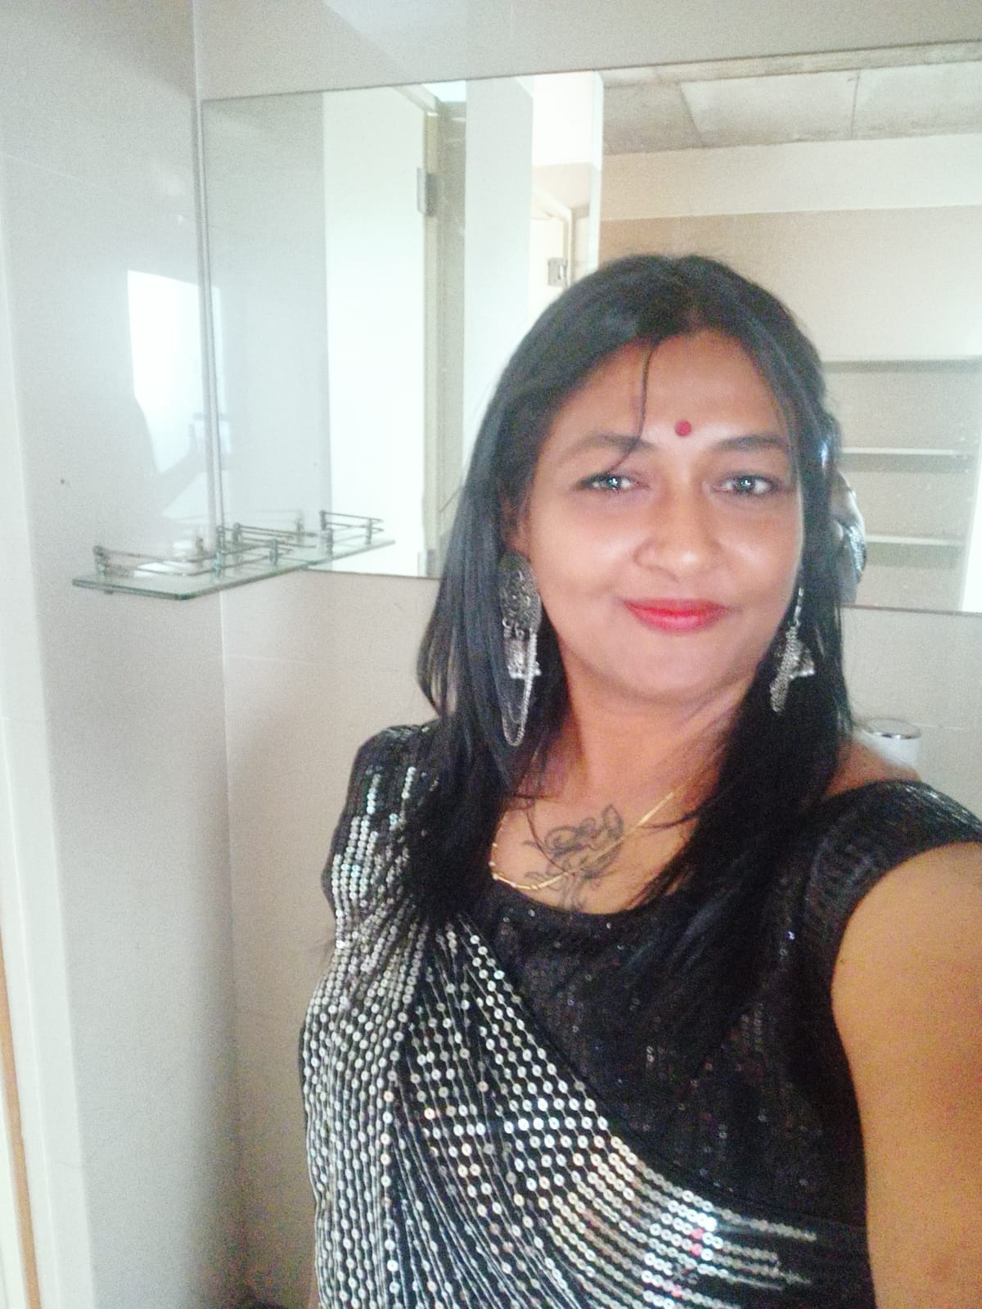
Jalpan Lala – Vice President-Gujarat
WICCI Entrepreneurship Development council
Jalpan Lala is a Ahmedabad based consultant for Event management. Her wide network across the country helps in managing events with effective sponsorship. Her major activities are :
Managing contact centre and Outsourced Business Processing (KPO – Knowledge Process Outsourcing) & US Mortgage
Claims Management, Business and Individual Verification services
Sales & Services of Computer Hardware (Kenya – Institutional and Government)
Media Management, organizing Marketing Expositions and Fund Raising
Content creation, Script writing and Media Communication activities

Slide 16
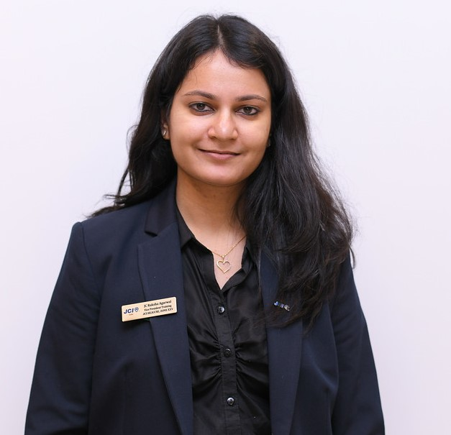
CA Raksha Agarwal – State president-West Bengal
WICCI Entrepreneurship Development council
CA Raksha Agarwal is the founder of Raksha Agarwal and Associates from Siliguri,West Bengal.She is the Founding member of GRAMP network spreading it’s wings with 18 Chartered Accountant.
She is a Global Startup Advisor, Founder of ThinkTax, Leadership member and Associate Manager at Aimbiz Global ,Tax Litigation Advisor, Legal and Compliance Expert at Business Charcha , Strategic Advisor at MSME business forum India.
She has expertise in areas like Virtual CFO Services,Startup funding and advisory, Global Tax restructuring, Investment Banking,Due Diligence,NBFC advisory and formation,Litigation in Income Tax matters.
Raksha Agarwal who was awarded the TALLY MSME HONOURS AWARDS 2023, Global Women Inspiration Award 2022,The Fox Story Award Inspiring 100 under 40 is a leading Chartered Accountant from West Bengal.She head her own CA firm and is associated with AimBiz Global,ThinkTax,GRAMP as the founding member. She is Global Startup Advisor and Virtual CFO to as many as 200+ startups.She is a strategic Advisor to MSME Business Forum India . She has expertise in other areas like Startup funding and advisory, Global Tax restructuring, Investment Banking,Due Diligence,NBFC advisory and formation, Litigation in Income Tax matters.

Slide 17
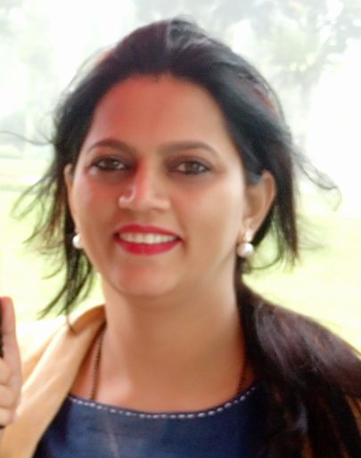
CHINNMAYE PRAVEEN – State President-Karnataka
WICCI Entrepreneurship Development council
CHINNMAYE PRAVEEN is a is a Founding Member & a Strategic Planner at M/s GeWinn
Wachstum – a community Water treatment organization.
is a PROFESSIONAL Counsellor – A FREE LANCE individual with expertise in CAREER COUNSELLING, TEEN AGE COUNSELLING, OLD-AGE Counselling, ACADEMIC Counselling, PARENTING and STRESS Management. So far over 180 counselling sessions are conducted inclusive of individual n group counseling at various SCHOOLS, CLUBS n other group programmes. Has received many accolades n appreciations from various forums on ability to counsel.
Memberships
Member at WOMEN EMPOWER FORUM.
MEMBER AT LAGU UDYOG BHARATHI – KARNATAKA.
PRESIDENT at MANINI MAHILA SAMAJ.
Member at Water Conservation Forum – Bangalore Chapter
ARTICLES n MEDIA PUBLICATIONS On
a) WOMEN n SOCIETY.
b) TIPS to Strategise.
c) Captivating LIFE
d) TIME management in Studying.
e) ENTREPRENEURING.
f) Women in Commercial World.

Slide 18
Shaghunam Madan – State President UP
WICCI Entrepreneurship Development council
Shagun is a philanthropist, a social entrepreneur and an investment banker with decades of extensive experience in India, UAE and Australia, serving diversified industries and sectors including public, private, and
government and not for profit organization
She is a founding member of Promise India Foundation, NGO for under
privilege women & children in India. She is on the board of few Indian listed companies as their Independent Director.
An eminent speaker on various public and professional forums of banks, universities, business schools, institutions like ICSI, etc. Receiver of many awards and recognitions on various platforms both at national and
international level.

Slide 19
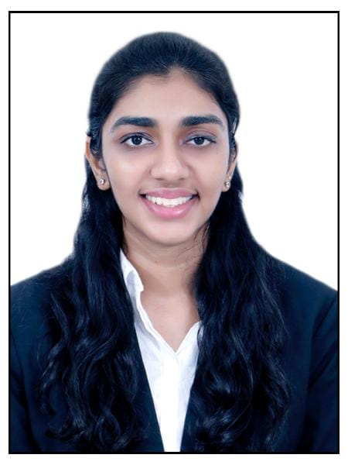
Swathi Yarabolu – State President - Telangana
WICCI Entrepreneurship Development council
Swathi is a graduate in computer science and have done MBA from IIM Indore. She is young enthusiastic professional interested to work for MSME in India.
She worked with JP morgan and Walmart as a software developer.
She is keen to support and inspire women in india to adopt digital technologies for their business growth and operations.

Slide 20
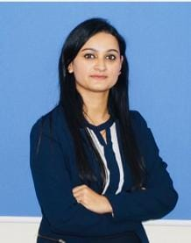
Preeti Nakoti – State President Delhi NCR
WICCI Entrepreneurship Development council
Preeti is goal-oriented and People focused HR professional with over a decade of comprehensive experience in devising and executing best-in-class HR vision, strategies and policies to shape high performing cultures.
Her area of expertise includes directing HR Operations, Talent Acquisition, Talent Management, Employee Engagement, Performance Management, Organisation redesign & structuring, HR Analytics, Payroll & Statutory Compliance etc. She is a dedicated HR professional delivering sustainable and large scale Talent Acquisition strategies and initiatives across diverse vertices while adapting to evolving demands to ensure organisation has right people/talent at right time.

Slide 21
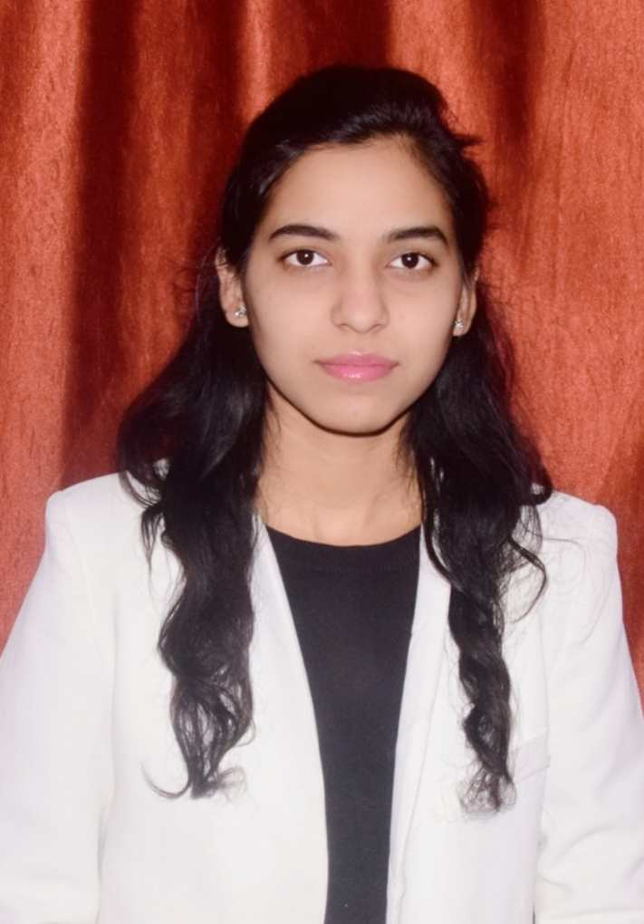
Sakshi Sharma – State VP UP
WICCI Entrepreneurship Development council
Sakshi Sharma based at Greater Noida, U.P. and working as Manager-Operations in Research & Development department.
She has recently started her new venture start-up named Adhrit Botanicals. Ayurveda and herbal products development such as healthcare products, oral care products, derma products, and herbal cosmetics.
She has developed Kumkumadi night serum, Hyaluronic Acid Serum, Glutathione Serum, Niacinamide Serums, Moisturizers, Gel cleansers, Cleansing milk, Body toning oils, shampoos, hair oils, hair serums, Joints & Muscle Pain Oil, Pain Ointments, Kidney Stone Syrup, Diabetes Powder, Muscle booster tonic, Female Hormone Regulator Tonic, Migraine Tea, Head Relaxant Massage Oil, Hand Wash and so.

Slide 22
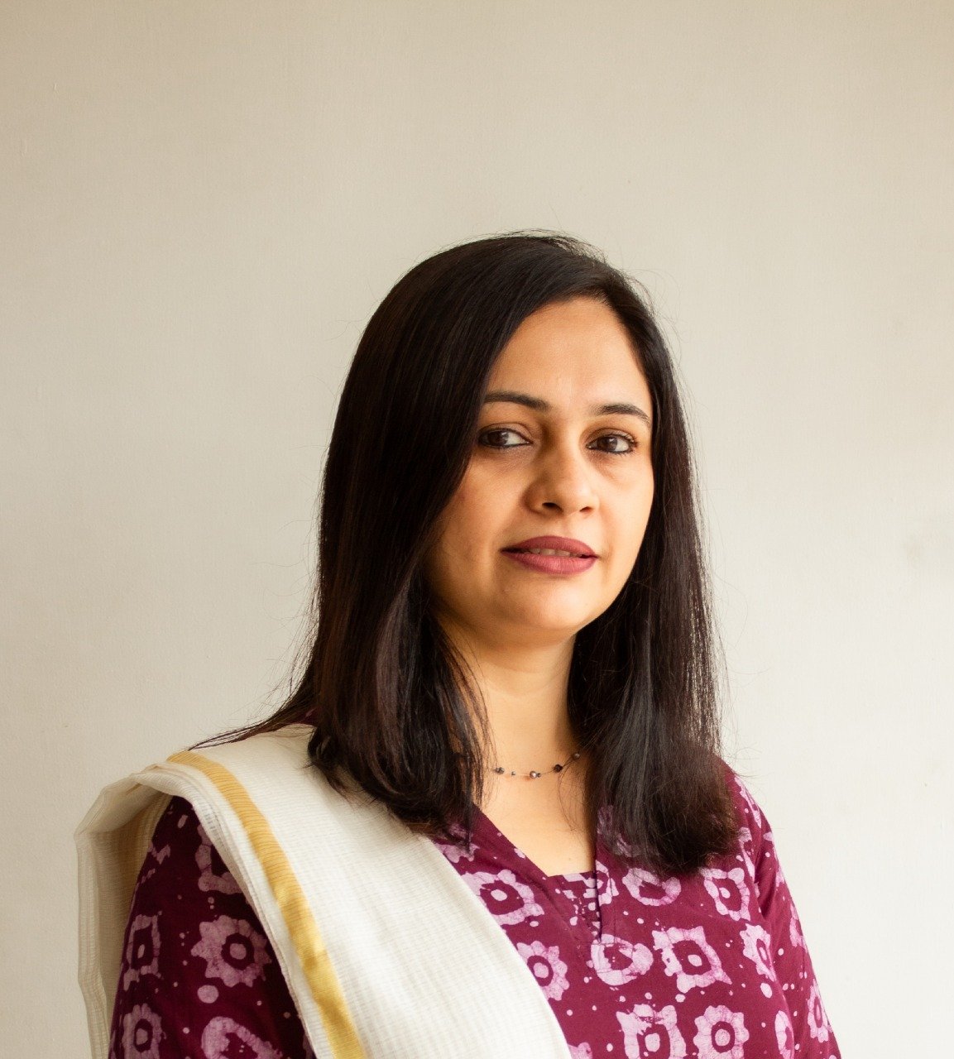
Rucha Acharya – National Council Member
WICCI Entrepreneurship Development council
Mrs. Rucha Acharya
Founder Director Revs Academy – Abacus & English
C/21, Trimurti Society, Ratnakar mata road, Kapadwanj – 387620 Dist-Kheda, GujaratQualification: MBA (HR)Work experience: 20 years in Education field and social work
Achievement: Established Abacus Academy for small towns and villages to enhance calculation skills in small child. Future Plan: provide employment to the young people in education field with very less investment.
Empower women to become self employed.

Slide 23
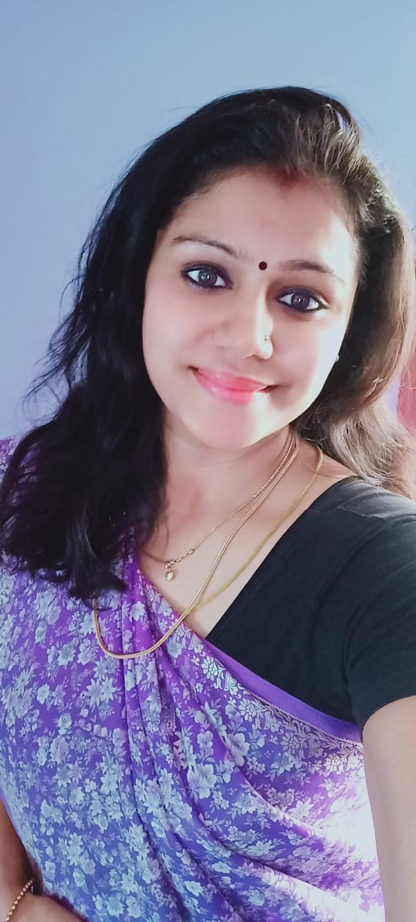
Dr Rajalakshmi Mohan –State president-Tamilnadu
WICCI Entrepreneurship Development council
Dr Rajalakshmi Mohan is an Acupuncture specialist and PHD in Alternative Medicine - Government certified Ayurveda Panchakarma
Member, Aayush International Medical Association
She is interested to provide career guidance about opportunities career in ayurveda or acupuncture

Slide 24
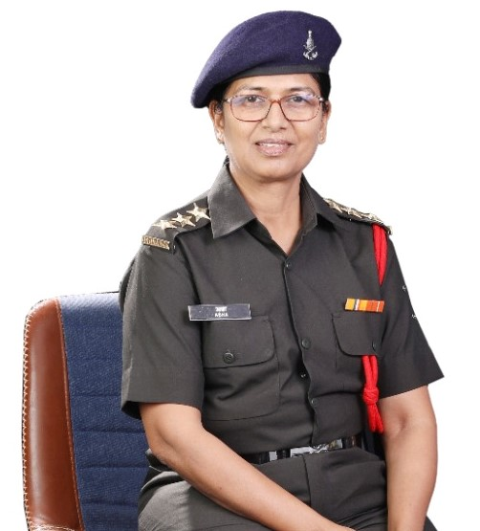
Capt. Asha Alagappa –State president-Maharastra
WICCI Entrepreneurship Development council
Capt. Asha Alagappa is a Season Veteran and the first Indian Women Army Ammunition and Explosive Expert,
Author of the book ‘ Be the Hero of your Life’.
Strategic Advisory & EC Member at 'MSME Business Forum(India)’
"Naam Foundation,
worked in Corporate for 2 decades as SME in defence business, last apt being Vice President at Iron Lady for women empowerment and leadership pan India role supporting 1000s of women.
founder of Gyan Darshani training with guidence to students to join defence as officers,
POSH Certified Internal Committee Expert and a Certified Defence Career Coach & Business Mentor for 3 Decades along with being the motivational and Keynote speakers to share my knowledge and experience in the education institutes and Corporates.

Slide 25

SUPPORTED BY
WICCI is supported by the massive global networks of ALL Ladies League (ALL), Women Economic Forum (WEF), and SHEconomy.
ALL is a movement of ‘Sisters Beyond Borders.’
WEF is a platform for ‘Business Beyond Borders.’ SHEconomy is e-commerce for women worldwide in Goods & Services for ‘Commerce Beyond Borders’

Slide 26


COUNTRIES REPRESENTED
Albania, Angola, Armenia, Argentina, Australia, Azerbaijan, Bangladesh, Brazil, Burundi, Cameroon, Canada, Chad, China, Costa Rica, Croatia, Cyprus, Czech Republic, Colombia, Ecuador, Egypt, Ghana, Germany, Greece, Guatemala, Hong Kong, Hungary, India, Italy, Israel, Ireland, Japan, Kazakhstan, Kenya, Kyrgyzstan, Lesotho, Luxembourg, Malawi, Malaysia, Mexico, Moldova, Monaco, Montenegro, Morocco, Mozambique, Malta, Netherlands, Nigeria, Nepal, New Zealand, North Macedonia, Norway, Paraguay, Portugal, Peru, Puerto Rico, Philippines, Qatar, Romania, Russia, Rwanda, Serbia, Singapore, Slovenia, Spain, South Africa, South Korea, Suriname, Sweden, Switzerland, Syria, Tunisia, Turkey, Uganda, Ukraine, UK, Uruguay, Venezuela, Vietnam, Virgin Islands (US), UAE, USA, Uzbekistan, Zimbabwe.

Slide 27
WOMEN'S INDIAN CHAMBER OF COMMERCE ANDINDUSTRY

